Slide 1

Semantic Kernel
Notes:
The Evolution of AI Agents and LLMs
AI has undergone a dramatic transformation—from rule-based systems to today’s agentic architectures powered by Large Language Models (LLMs).
Early AI agents were built on rigid, rule-based logic. These systems could automate simple, well-defined tasks but struggled with complexity, nuance, and adaptability.
The introduction of machine learning allowed agents to learn from data, adapt to new scenarios, and improve over time. This shift unlocked dynamic, scalable AI applications.
The real breakthrough came with transformer-based LLMs like GPT-4, which can understand context, generate human-like responses, and reason over vast amounts of information.
Modern AI agents leverage LLMs as their core reasoning engine, but go further: they integrate memory, planning, tool use, and environmental interaction. This enables agents to autonomously perceive, decide, and act toward complex goals.
Agentic AI is about orchestrating these capabilities—reasoning, planning, acting, and learning—often in multi-agent systems that collaborate, delegate, and refine outcomes. Agents can now automate workflows, interact with humans, and solve problems that were previously out of reach for traditional AI.
Key technical enablers include larger context windows, multi-modality (text, image, audio), retrieval-augmented generation (RAG), and specialized agents for rapid, cost-effective execution.
Semantic Kernel and similar frameworks (AutoGen, LangChain, CrewAI) are at the forefront, enabling developers to build modular, scalable agentic systems that bridge natural language and enterprise logic.
In summary: The evolution from basic LLMs to agentic architectures marks a paradigm shift. AI agents are no longer just conversationalists—they are autonomous collaborators, planners, and actors, driving innovation across industries.

Slide 2
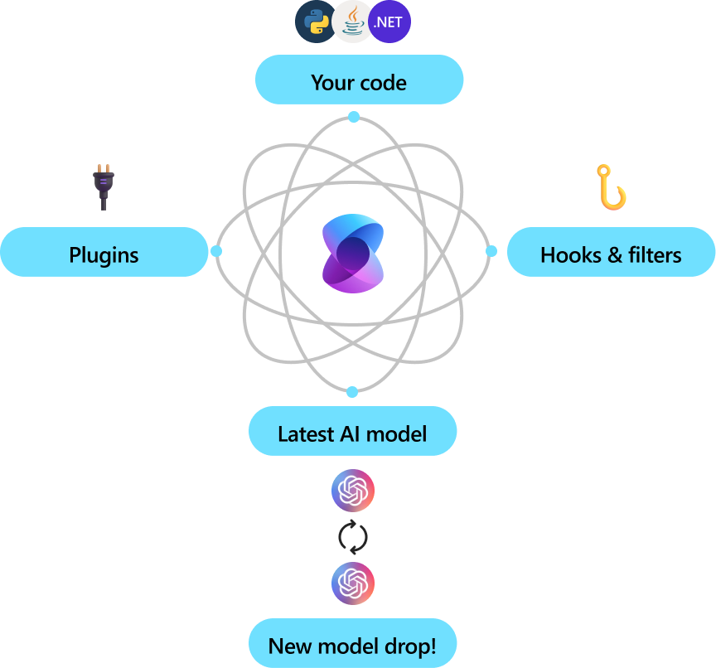
What is Semantic Kernel?
SDK for building AI-first applications
Coordinates models, memory, and external functions
Works across LLM providers (Azure, OpenAI, HuggingFace)
Enables agent-based and function-calling architectures
Bridges natural language input and system logic
Notes:
Semantic Kernel is a modular SDK for building AI-first applications that orchestrate models, memory, and external functions in a unified, extensible architecture.
It abstracts the complexity of integrating multiple LLM providers (Azure OpenAI, HuggingFace, etc.), allowing developers to select, swap, or ensemble models for specific tasks and performance requirements.
Agent-based and function-calling architectures: Semantic Kernel enables the creation of intelligent agents that reason, plan, and act by invoking plugins, APIs, and enterprise services. This supports automation of complex workflows and seamless interaction between natural language and system logic.
Plugin architecture: Plugins expose native code functions (C#, Python), REST/OpenAPI endpoints, and enterprise workflows. Agents can dynamically extend their capabilities and interact with external systems, supporting rapid prototyping and modular design.
Memory and context management: Semantic Kernel supports both volatile (short-term) and persistent (long-term) memory via vector stores (e.g., Azure Cognitive Search, Redis), enabling context-aware and personalized AI experiences.
Cross-provider abstraction: By bridging natural language input with system logic, Semantic Kernel allows applications to remain flexible and future-proof as new models and providers emerge.
Enterprise-grade extensibility: The SDK is designed for integration into existing systems, supporting compliance, security, and scalability requirements typical of enterprise environments.
Visual: The diagram illustrates how Semantic Kernel acts as the central orchestrator, coordinating your code, plugins, hooks, filters, and the latest AI models to deliver intelligent, adaptive solutions.

Slide 3
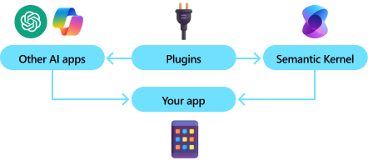
Why Semantic Kernel?
Built for real-world, enterprise-grade applications
Designed for integrating AI into existing systems
Azure-native: seamless integration with Azure AI services
Modular: easy to swap or extend components (e.g., memory, services)
Encourages clean design via plugins and orchestration
Reduces boilerplate with agent abstractions
Notes:
Semantic Kernel is engineered for enterprise-grade AI solutions, with a focus on modularity, extensibility, and seamless integration into existing systems.
The SDK leverages a plugin-based architecture, enabling developers to inject custom logic, connect to external APIs, and orchestrate complex workflows with minimal boilerplate.
Azure-native integration: Semantic Kernel is optimized for Azure AI services, supporting direct connections to Azure OpenAI, Cognitive Search, and other cloud-native components. This allows for scalable deployments, secure data handling, and compliance with enterprise standards.
Modular design: Core components such as memory stores, service connectors, and orchestration logic can be swapped or extended via configuration, supporting rapid prototyping and iterative development. For example, you can switch between Redis, Azure Cognitive Search, or in-memory vector stores for context management.
Clean code and maintainability: The plugin and orchestration model encourages separation of concerns, making it easier to manage dependencies, update functionality, and maintain code quality over time.
Agent abstractions: Semantic Kernel provides agentic patterns that encapsulate reasoning, planning, and tool use, reducing repetitive code and enabling developers to focus on business logic and user experience.
Visual: The diagram illustrates how Semantic Kernel acts as the central orchestrator, connecting your app and external AI services through plugins, hooks, and filters, ensuring adaptive and intelligent solutions.

Slide 4
Core Components
Kernel: Brain of the system
AI Service Connectors: LLMs, embeddings, etc.
Plugins/Functions: Callable functions for LLM
Memory (Vector Stores) Connectors: for RAG with vector stores
Filters – Middleware for function/model execution
Prompts
Notes:
Semantic Kernel’s architecture is built around several core components that enable modular, scalable, and enterprise-grade AI solutions:
Kernel: Acts as the central orchestrator, coordinating interactions between models, plugins, memory, planners, and external services. The kernel manages execution flow, context propagation, and lifecycle of agentic operations.
AI Service Connectors: Abstracts access to LLMs, embeddings, and other AI capabilities. Connectors provide a unified interface for integrating multiple providers (Azure OpenAI, HuggingFace, etc.), supporting model selection, chaining, and ensemble strategies.
Plugins/Functions: Expose callable functions to the kernel, including native code (C#, Python), REST/OpenAPI endpoints, and enterprise workflows. Plugins enable agents to invoke business logic, automate tasks, and interact with external systems dynamically.
Memory (Vector Store) Connectors: Integrate with vector databases (Azure Cognitive Search, Redis, FAISS, Qdrant, etc.) to support retrieval-augmented generation (RAG), persistent and volatile memory, and semantic search. This enables context-aware reasoning and long-term personalization.
Filters: Serve as middleware for function and model execution. Filters enforce security (permission checks), observability (logging, telemetry), reliability (retries, fallback), and safety (prompt redaction, result overrides) at every invocation.
Prompts: Define programmable instructions for LLMs, supporting template engines (native, Handlebars, Jinja2, Liquid) and semantic functions. Prompts orchestrate agent behavior, control output formats, and enable composable, context-driven workflows.
Technical Note:
These components are designed for extensibility and compliance, supporting dependency injection, configuration-driven orchestration, and integration with enterprise governance frameworks.
The modular design allows rapid prototyping, iterative development, and seamless scaling across cloud and hybrid environments.

Slide 5
Core Components
Term | What it Means
Kernel | The central orchestrator. It coordinates everything – models, plugins, memory, planners – like a brain connecting to all your AI app’s moving parts.
Plugin (Skill) | A class or API you expose to the AI. Plugins can be native C# methods([KernelFunction]) or REST/OpenAPI endpoints – they’re how your agent “acts” in the world.
Planner | The logic engine that interprets user goals and creates step-by-step execution plans using your plugins. Examples: FunctionCallingPlanner, StepwisePlanner
Memory | A vector store (like Azure Cognitive Search or Redis) used to store and recall facts, embeddings, and context across conversations.
Prompt | A human-readable instruction that kickstarts AI interaction. SK uses prompts + plugins together to go beyond single-shot completions.
Execution Settings | Parameters like temperature, top_p, and max tokens – SK lets you fine-tune these per task via prompt settings.
Context | A running state object SK uses to pass data, variables, memory, and intermediate results through planners and plugins.
Notes:
Microsoft calls this orchestrated AI – not just calling GPT, but composing LLMs + tools + memory into real, reusable systems.

Slide 6
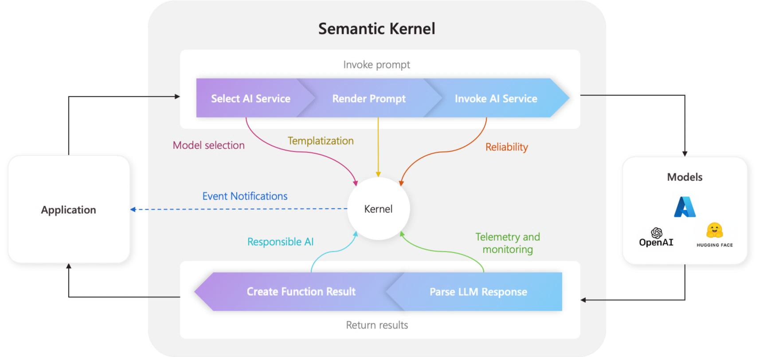
Kernel
What does the kernel do?
🧠 Reasoning | Uses LLMs to interpret user intent
🛠️ Execution | Calls the right plugin function (C#, REST API, or prompt)
🧭 Planning | Breaks down complex tasks into steps (if using a planner)
🧠 Memory | Stores and retrieves context or facts
🔌 Integration | Connects to services like OpenAI, embeddings, storage, etc.
Notes:
The Kernel is the central orchestrator in Semantic Kernel, responsible for managing all AI operations and agentic workflows.
Reasoning: The kernel leverages large language models (LLMs) to interpret user intent, enabling context-aware understanding and dynamic goal decomposition.
Execution: Based on interpreted intent, the kernel invokes the appropriate plugin function—this could be a native method (C#, Python), a REST API, or a prompt-based semantic function. This abstraction allows seamless integration of business logic and external services.
Planning: When using planners (e.g., FunctionCallingPlanner, StepwisePlanner), the kernel can break down complex tasks into multi-step execution plans, orchestrating tool use and agent collaboration.
Memory: The kernel manages both short-term and long-term memory, storing and retrieving context, facts, and embeddings via vector stores (e.g., Azure Cognitive Search, Redis). This enables persistent personalization and retrieval-augmented generation (RAG).
Integration: The kernel connects to external AI services (OpenAI, Azure, HuggingFace), embeddings, storage, and enterprise systems, supporting extensibility and interoperability across cloud and hybrid environments.
Lifecycle Management: The kernel handles context propagation, execution flow, error handling, and telemetry, ensuring robust, observable, and compliant AI operations.
Visual: The diagram illustrates how the kernel manages prompts, selects models, renders prompts, invokes AI services, and returns results to the application, highlighting the modular and extensible nature of the architecture.

Slide 7
Plugins/Functions
Tools the kernel can call to take action.
Types:
Native – Code functions (Python/C#)
OpenAPI – External APIs
Logic Apps – Enterprise workflows
MCP
etc
Notes:
Plugins in Semantic Kernel act as extensible components that enable AI agents to interact with external systems, APIs, databases, and services. While Skills define what an AI agent can do internally, Plugins allow it to reach beyond its own environment to perform tasks in the real world.
Key Functions of Plugins:
Integration with External Services: Connect to third-party APIs like Microsoft Graph, Azure Cognitive Services, or custom REST endpoints.
Custom Functionality: Add specialized capabilities that are not natively supported within Semantic Kernel.
Dynamic Loading: Plugins can be loaded or updated without modifying the core application, enabling flexibility and modular design.
How Plugins Differ from Skills:
Sills are task-oriented, focusing on internal logic and AI processing
Plugins are integration-oriented, enabling connectivity with external systems and services.

Slide 8




With plugins, AI can automate tasks
Semantic Kernel
ChatGPT
M365 Copilot
Bing
Your application
Chatbots are nice, but they aren’t useful to your users until they can interact with the real world by…
Retrieve data
Sending emails
Completing sales
Making orders
And more!
1
2
AI Plugins
3
4
5
Notes:
Semantic Kernel’s plugin architecture is a key enabler for enterprise-grade automation and extensibility.
Plugins act as callable tools that the kernel can invoke to interact with external systems, APIs, databases, and enterprise workflows.
Types of Plugins:
Native code functions: Written in Python or C#, these allow direct invocation of business logic or data processing routines.
OpenAPI/REST endpoints: Enable integration with third-party services, microservices, or SaaS platforms.
Logic Apps and enterprise workflows: Facilitate orchestration of complex business processes, approvals, and transactional operations.
Why plugins matter:
They transform AI agents from simple conversational bots into actionable automation engines.
Agents can retrieve data, send emails, complete sales, place orders, and more—bridging the gap between natural language understanding and real-world execution.
Plugins are dynamically loadable and updatable, supporting modular design and rapid prototyping.
Technical advantages:
Decouples AI logic from system integration, promoting maintainability and scalability.
Supports secure, auditable interactions with enterprise systems, ensuring compliance and governance.
Enables multi-agent and multi-tool orchestration, allowing agents to collaborate and delegate tasks across heterogeneous environments.
Visual:
The diagram illustrates how plugins connect Semantic Kernel to external AI services (e.g., ChatGPT, M365 Copilot, Bing) and your own applications, enabling adaptive, intelligent automation.

Slide 9
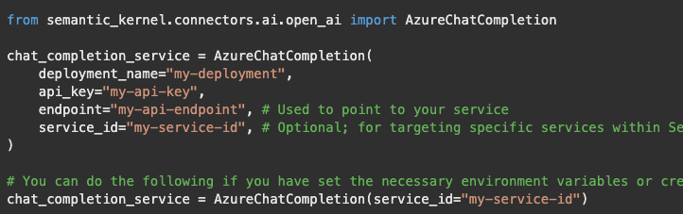
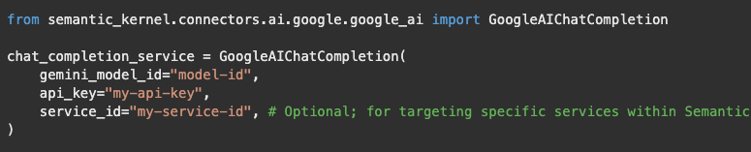
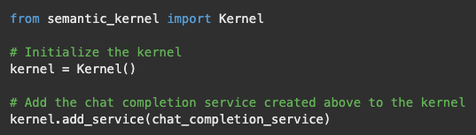
AI Service Connectors
Connects the kernel external AI capabilities. Each connector wraps a model or API and exposes a common interface
Examples:
Chat Completion, Text Generation,
Text to Image, Image to Text,
Text to Audio, Audio to Text
Notes:
Connectors: Bridging Systems from Seamless Interaction
While Plugins extend functionality, Connectors serve as the communication bridge between Semantic Kernel and external data sources, APIs, or services. They are designed to handle the technical details of data transmission, such as authentication, request formatting, and error handling.
Roles of Connectors:
Data Flow Management: Ensure smooth data exchange between Semantic Kernel and external systems
Protocol Handling: Manage different communication protocols like HTTP, WebSocket, or gRPC.
Security and Authentication: Handle API keys, OAuth tokens, and secure connections.
Why Connectors are Important
They abstract complexity, allowing developers to focus on business logic without worrying about the intricacies of API communication.
They promote interoperability, enabling Semantic Kernel to function seamlessly in multi-cloud and hybrid environments.
In summary, connectors make Semantic Kernel highly extensible and adaptable to evolving AI technologies.

Slide 10
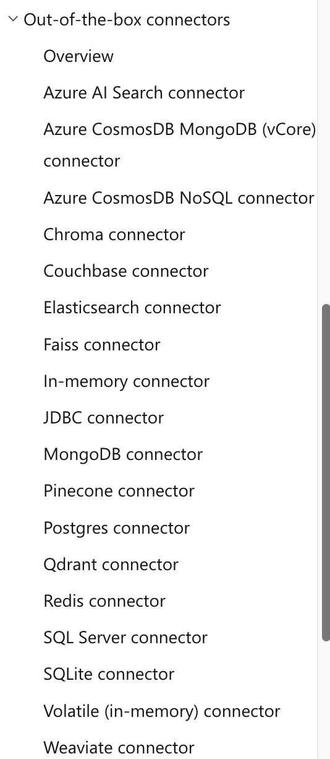
Memory (Vector Store) Connectors
Expose vector stores from different providers
Useful for context recall and grounding
Supports:
In-Memory
Azure Search,
FAISS,
Qdrant,
Redis
and more
Notes:
In traditional AI systems, each interaction is often processed in isolation, with no awareness of prior context. Memory in Semantic Kernel changes this paradigm by enabling AI agents to retain and recall information across interactions, making them more context-aware, personalized, and dynamic.
Types of Memory:
Volatile Memory (Short-Term Memory)
Stores information temporarily during an ongoing session. It’s ideal for maintaining conversational context, such as remembering the user’s last question or recent topic of discussion.
Persistent Memory (Long-Term Memory)
Retains information across sessions, allowing AI agents to “remember” user preferences, historical data, and past interactions. This is crucial for personalization in applications like virtual assistants, customer support bots, and recommendation engines.
Key Capabilities of Semantic Kernal’s Memory:
Contextual Retrieval: AI agents can recall relevant data based on the current context, enabling coherent and natural conversations.
Semantic Search: Memory isn’t limited to keyword-based retrieval. Semantic Kernel supports vector-based semantic search, allowing agents to find information based on meaning rather than exact matches.
Knowledge Management: Memory can be structured to act as a knowledge base, supporting complex reasoning and decision making.

Slide 11
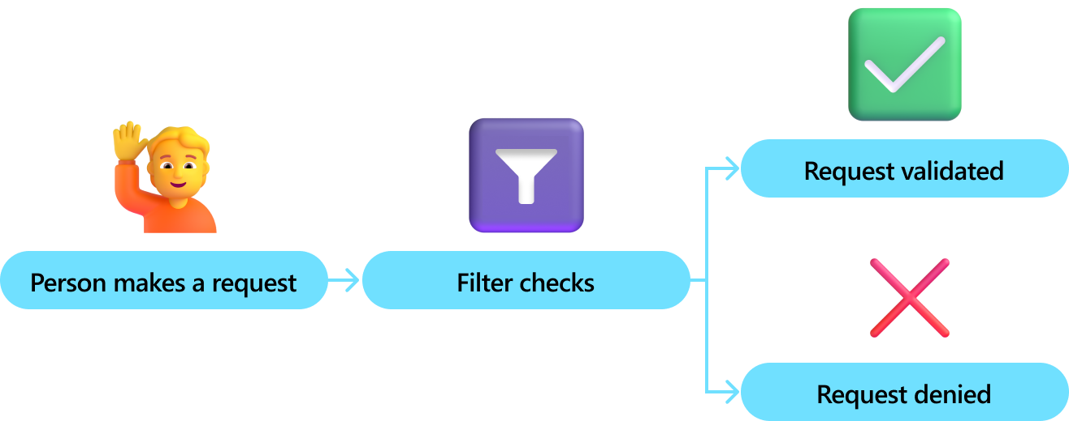
Filters
Think of filters as middleware — they run before and after a function or model is called.
They’re essential for:
✅ Security — permission checks
📊 Observability — logging, telemetry
🔁 Reliability — retries, fallback
🧹 Safety — prompt redaction, result override
Types:
Function Invocation Filter
Prompt Render Filter
Automatic Function Invocation Filter
Notes:
Filters in Semantic Kernel act as middleware, providing a layer of control and oversight for every function or model invocation.
Security: Filters can enforce permission checks, ensuring only authorized users or processes can execute sensitive functions or access protected data.
Observability: By integrating logging and telemetry, filters enable detailed monitoring of function calls and model interactions. This is crucial for debugging, auditing, and understanding system behavior in production environments.
Reliability: Filters can implement retry logic and fallback mechanisms, automatically handling transient errors or failures. This increases the robustness of AI workflows, especially when integrating with external APIs or services.
Safety: Filters support prompt redaction and result overrides, helping prevent the exposure of sensitive information and ensuring outputs remain within compliance boundaries.
Types of Filters:
Function Invocation Filter: Runs before and after a function is called, allowing for pre-processing (e.g., input validation) and post-processing (e.g., output sanitization).
Prompt Render Filter: Applies checks and transformations to prompts before they are sent to the model, ensuring prompts are safe and contextually appropriate.
Automatic Function Invocation Filter: Dynamically manages which functions are invoked based on context, user intent, or system state.
In summary: Filters are a foundational component for building secure, reliable, and observable AI applications with Semantic Kernel. They enable organizations to enforce policies, monitor activity, and maintain high standards of safety and compliance.

Slide 12
Prompts
A prompt is a programmable instruction to an LLM — it defines what the model knows, how it behaves, and what it returns.
Prompt Templates
Define reusable natural language instructions
Can be defined inline or loaded from external files
Use variables and function calls (e.g., {{name}}, {{math.add $x $y}})
Semantic Function
Prompts can be registered as callable functions
Template Engine Support
Supports Semanti-Kernel native , Handlebars, Jinja2, Liquid
Notes:
Prompts are the foundation of how Semantic Kernel interacts with large language models (LLMs).
A prompt is more than just a question—it's a programmable instruction that defines the model’s knowledge, behavior, and output format.
Prompt Templates:
Templates allow you to create reusable, parameterized instructions for your AI agents.
You can define prompts inline within your code or load them from external files for better maintainability and collaboration.
Templates support variables and function calls, enabling dynamic content generation. For example, you can inject user names, contextual data, or even results from other functions directly into the prompt.
Semantic Functions:
Prompts can be registered as callable functions within Semantic Kernel, allowing you to treat natural language instructions as first-class components in your application.
This enables seamless integration of LLM-powered logic with traditional code and APIs.
Template Engine Support:
Semantic Kernel supports multiple template engines, including its native format, Handlebars, Jinja2, and Liquid.
This flexibility allows teams to use familiar syntax and leverage existing tooling for prompt authoring and management.
Why Prompts Matter:
Well-designed prompts are critical for controlling model behavior, ensuring reliability, and achieving consistent results.
By combining prompt templates with plugins and memory, you can orchestrate complex workflows and multi-step reasoning in your AI applications.
Summary:
Prompts in Semantic Kernel are not just static text—they are programmable, composable, and deeply integrated into the orchestration framework. They empower developers to build sophisticated, context-aware AI solutions that go beyond simple question-answering.

Slide 13
Hands-on
Create a kernel
Add a chat completion service
Add several plugins (native, OpenAPI, prompt-based)
Add memory storage
Add filters
Notes:
Use one of the markdown files. They can use C# or Python.

Slide 14
Semantic Kernel Learning Resources
Develop generative AI apps with Azure OpenAI and Semantic Kernel
Develop AI agents on Azure
Create agentic AI solutions by using Azure AI Foundry V1
Microsoft Certified: Azure AI Engineer Associate

Slide 15




What is an agent?
Project manager agent
Wraps a Kernel with extra orchestration logic
Designed for LLM-powered conversations
Manages:
System prompt (persona/instructions)
Chat history
Function-calling behavior
Access to plugins and memory
Researcher agent
Copywriter agent
Designer agent
Notes:
Agents are a central abstraction in Semantic Kernel for orchestrating intelligent, context-aware interactions.
An agent wraps the Kernel, adding orchestration logic that’s specifically designed for LLM-powered conversations and workflows.
Key responsibilities of an agent:
System prompt management: Agents define and maintain the persona or instructions that guide the conversation, ensuring consistent behavior and tone.
Chat history: Agents track the full dialogue context, enabling multi-turn conversations and allowing the AI to reference previous exchanges for continuity and relevance.
Function-calling behavior: Agents determine when and how to invoke plugins, APIs, or other functions, enabling dynamic tool use and automation within the conversation.
Access to plugins and memory: Agents leverage plugins to interact with external systems and use memory to recall facts, context, or user preferences across sessions.
Agent types are highly customizable: You can create agents tailored for specific roles—such as project manager, researcher, copywriter, or designer—each with unique orchestration logic and access to relevant tools and data.
Why agents matter: By encapsulating orchestration logic, agents enable scalable, modular, and reusable AI solutions that go beyond simple chatbots. They support advanced scenarios like multi-agent collaboration, workflow automation, and human-in-the-loop processes.
Summary: Agents in Semantic Kernel are the key to building sophisticated, conversational AI systems that can reason, plan, and act—bridging the gap between natural language and enterprise-grade automation.

Slide 16
Core Built‑In Agent Types
ChatCompletionAgent
Manages contextual dialogues with chat-history and tool support
AzureAIAgent
Uses Azure AI Agent Service with server-managed threads
CopilotStudioAgent
Integrates with Copilot Studio environments
OpenAIAssistantAgent
Utilizes OpenAI Assistants API for richer conversations with file/tool integrations
OpenAIResponsesAgent
Built on OpenAI “Responses” endpoint for structured chat flows
Notes:
Semantic Kernel provides several built-in agent types, each designed to address specific conversational and orchestration scenarios.
ChatCompletionAgent:
This agent specializes in managing contextual dialogues, maintaining chat history, and supporting tool invocation within conversations.
It’s ideal for scenarios where continuity and context are critical, such as customer support bots or virtual assistants.
AzureAIAgent:
Integrates directly with Azure AI Agent Service, leveraging server-managed threads for scalable, enterprise-grade deployments.
This agent is well-suited for organizations already invested in Azure, enabling seamless integration with cloud-native AI capabilities and infrastructure.
CopilotStudioAgent:
Designed for use within Copilot Studio environments, this agent enables rapid prototyping and deployment of conversational experiences.
It’s particularly useful for teams building custom copilots or extending Microsoft 365 Copilot functionality.
OpenAIAssistantAgent:
Utilizes the OpenAI Assistants API, supporting richer conversations that can include file and tool integrations.
This agent is optimal for advanced use cases requiring multi-modal interactions or integration with external knowledge sources.
OpenAIResponsesAgent:
Built on the OpenAI “Responses” endpoint, this agent enables structured chat flows and can be tailored for specific conversational patterns.
It’s useful for scenarios where predictable, template-driven responses are required, such as FAQ bots or guided workflows.
Summary:
These built-in agents provide a robust foundation for building conversational AI solutions, allowing developers to choose the best fit for their application’s requirements and infrastructure.
By leveraging these agents, organizations can accelerate development, ensure best practices, and focus on delivering value through intelligent automation and orchestration.

Slide 17
Agent Orchestration
Sequential: Agents act in order, passing results along
Concurrent: Multiple agents work in parallel
Handoff: Control transfers based on conditions
Group Chat/Magnetic: Agents collaborate in a shared context
Human-in-the-Loop: Supports manual intervention during orchestration
Notes:
The field of AI is rapidly evolving, and the need for more sophisticated, collaborative, and flexible agent-based systems is growing. With this in mind, Semantic Kernel introduces a new multi-agent orchestration framework that enables developers to build, manage, and scale complex agent workflows with ease.
Traditional single-agent systems are limited in their ability to handle complex, multi-faceted tasks. By orchestrating multiple agents, each with specialized skills or roles, we can create systems that are more robust, adaptive, and capable of solving real-world problems collaboratively. Multi-agent orchestration in Semantic Kernel provides a flexible foundation for building such systems, supporting a variety of coordination patterns.
Agent orchestration is a foundational concept in Semantic Kernel, enabling complex workflows and multi-agent collaboration.
Sequential orchestration: Agents execute tasks in a predefined order, passing results from one agent to the next. This pattern is ideal for scenarios where each step depends on the output of the previous agent, such as multi-stage data processing or document review pipelines.
Concurrent orchestration: Multiple agents operate in parallel, each tackling a portion of the task independently. Results are aggregated at the end. This approach is well-suited for solution generation, brainstorming, or tasks that can be decomposed into independent subtasks.
Handoff orchestration: Control is dynamically transferred between agents based on conditions or task requirements. For example, a support agent may escalate technical issues to a specialist agent or route billing questions to a finance agent. This pattern supports escalation flows and dynamic task routing.
Group Chat/Magnetic orchestration: Agents collaborate in a shared conversational context, often managed by a central orchestrator. This enables team-based problem solving, brainstorming, and cross-functional discussions, with agents representing different domains or expertise.
Human-in-the-Loop: Semantic Kernel supports manual intervention during orchestration, allowing humans to participate in decision-making, provide input, or override agent actions. This is critical for workflows that require oversight, approvals, or nuanced judgment.
Summary: By supporting multiple orchestration patterns, Semantic Kernel empowers developers to build flexible, scalable, and intelligent AI solutions that mirror real-world collaboration and decision-making processes.

Slide 18
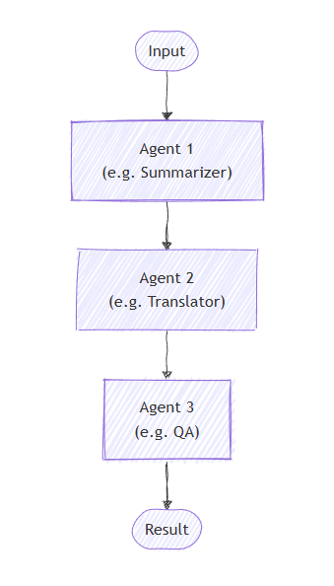
Sequential Orchestration
Notes:
Sequential orchestration is a foundational pattern in Semantic Kernel for managing multi-step workflows.
In this approach, agents are arranged in a strict order or a pipeline, with each agent performing a specific function and passing its output to the next agent in the sequence.
This pattern is ideal for scenarios where each stage of processing depends on the results of the previous stage. For example, you might start with a summarizer agent to condense input data, then pass the summary to a translator agent, and finally send the translated text to a QA agent for validation.
Sequential orchestration ensures that complex tasks are broken down into manageable steps, with clear handoffs and dependencies between agents.
This design promotes modularity and maintainability, as each agent can be developed, tested, and updated independently.
It’s especially useful for document processing pipelines, multi-stage data transformations, and workflows that require strict ordering and traceability.
Summary: By leveraging sequential orchestration, Semantic Kernel enables developers to build robust, auditable AI workflows that mirror real-world processes and ensure reliable outcomes.

Slide 19
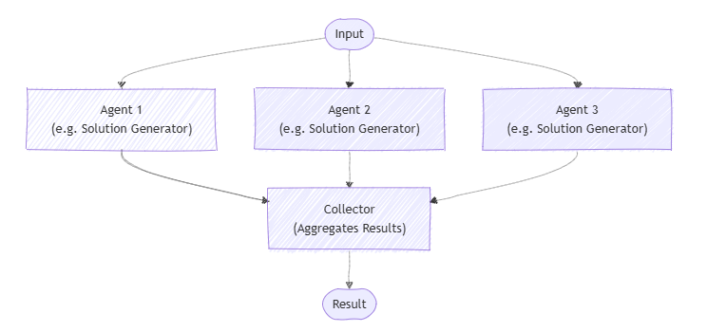
Concurrent Orchestration
Notes:
Concurrent orchestration is a powerful pattern in Semantic Kernel for enabling parallel processing and collaborative problem solving.
In this approach, multiple agents work simultaneously, or in parallel, each handling a distinct aspect or subtask of the overall workflow.
This pattern is ideal for scenarios where tasks can be decomposed into independent components—such as generating multiple solutions, brainstorming ideas, or processing large datasets in parallel.
Each agent receives the same input or a partitioned subset, performs its specialized function, and then passes its output to a central collector or aggregator.
The collector is responsible for combining, evaluating, or selecting the best results from the agents, ensuring a cohesive outcome.
Concurrent orchestration can dramatically improve efficiency and scalability, especially in environments where time-to-solution is critical or where diverse perspectives are valuable.
This design also supports modularity, allowing agents to be developed and maintained independently, and promotes resilience by enabling fallback or redundancy if one agent fails.
Summary: By leveraging concurrent orchestration, Semantic Kernel empowers developers to build robust, scalable AI workflows that harness the strengths of multiple agents working in parallel, driving innovation and accelerating results.

Slide 20
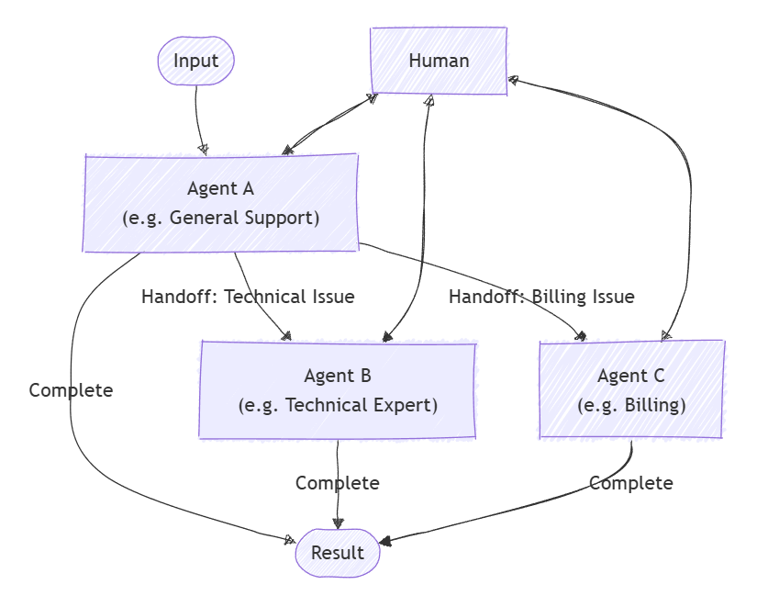
Handoff Orchestration
Notes:
Handoff orchestration is a dynamic pattern in Semantic Kernel that enables flexible, condition-based routing of tasks between agents and humans.
In this approach, a primary agent (such as a general support agent) handles incoming requests and determines, based on context or issue type, whether to escalate or transfer control to a specialized agent or a human operator.
For example, technical issues may be routed to a technical expert agent, while billing questions are handed off to a finance agent. If the situation requires nuanced judgment or manual intervention, the workflow can escalate to a human participant.
This pattern is essential for real-world scenarios where not all problems can be solved by a single agent or require expertise from different domains. It supports escalation flows, dynamic task routing, and ensures that each request is handled by the most appropriate resource.
Handoff orchestration promotes modularity and maintainability, allowing organizations to build robust support systems, escalation pipelines, and collaborative workflows that blend AI automation with human oversight.
Summary: By leveraging handoff orchestration, Semantic Kernel empowers developers to create intelligent systems that can adapt to complex, evolving requirements, ensuring that tasks are resolved efficiently and accurately by the right agent or human at the right time.

Slide 21
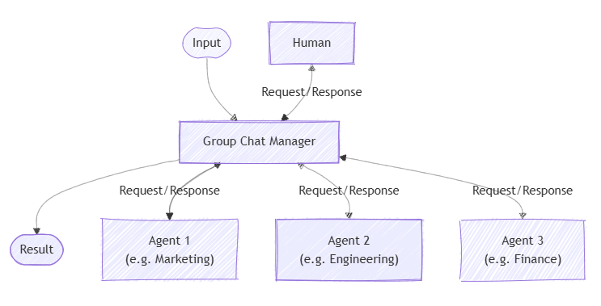
Group Chat Orchestration
Notes:
Group Chat Orchestration is a collaborative pattern in Semantic Kernel that enables multiple agents—and humans—to interact in a shared conversational context.
In this approach, a Group Chat Manager coordinates the flow of requests and responses among agents representing different domains or expertise, such as marketing, engineering, and finance.
Agents “converse” openly in a shared thread, allowing for real-time brainstorming, team-based problem solving, and cross-functional discussions.
This pattern is especially valuable for scenarios that require diverse perspectives, collective decision-making, or rapid information exchange.
Human participants can join the conversation, providing input, guidance, or oversight alongside the agents. This supports hybrid workflows where AI and human expertise are combined.
Group Chat Orchestration promotes transparency, inclusivity, and agility, making it ideal for collaborative environments, project teams, and dynamic business processes.
Summary: By leveraging group chat orchestration, Semantic Kernel empowers organizations to build intelligent systems that mirror real-world teamwork, foster innovation, and accelerate outcomes through multi-agent and human collaboration.

Slide 22
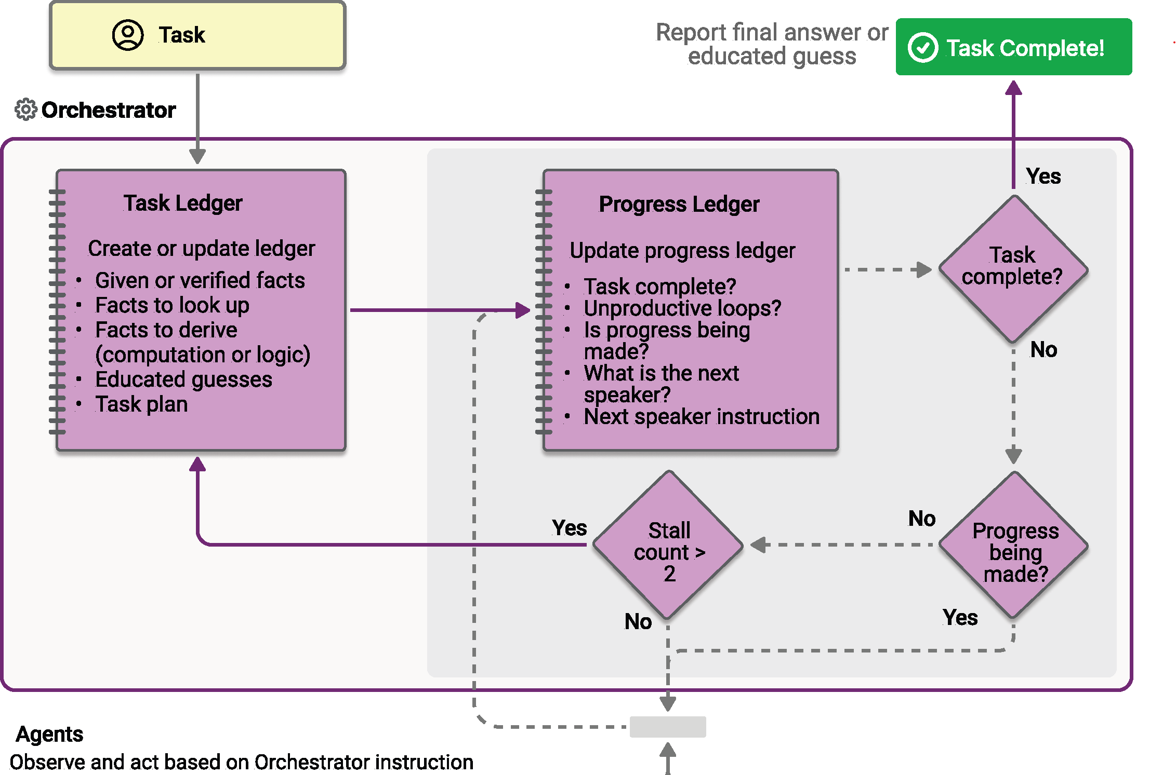
Magentic (Dynamic Routing)
Notes:
Magnetic orchestration, also known as dynamic routing, is an advanced pattern in Semantic Kernel for adaptive, context-driven agent collaboration.
Magentic orchestration is designed based on the MagenticOne pattern invented by AutoGen. It is a flexible, general-purpose multi-agent pattern designed for complex, open-ended tasks that require dynamic collaboration.
In this approach, an orchestrator manages a central ledger of tasks, progress, and contextual facts. The orchestrator continuously evaluates the state of the workflow and dynamically delegates control to the agent best suited for the current step or challenge.
Agents do not operate in a fixed sequence or parallel; instead, they are “pulled in” as needed based on their expertise, the nature of the task, and real-time progress.
This pattern is ideal for complex, evolving workflows where requirements may change, bottlenecks may arise, or specialized intervention is needed at different stages.
The orchestrator tracks progress, detects stalls or unproductive loops, and can escalate to a human or switch agents if necessary. This ensures that the workflow remains efficient, responsive, and resilient to unexpected challenges.
Magnetic orchestration supports advanced scenarios such as multi-step reasoning, collaborative problem solving, and adaptive automation, making it a powerful tool for enterprise-grade AI solutions.
Summary: By leveraging magnetic (dynamic routing) orchestration, Semantic Kernel enables organizations to build intelligent systems that adapt in real time, optimize resource allocation, and deliver robust outcomes even in complex, unpredictable environments.
Use case example:
A user requests a comprehensive report comparing the energy efficiency and CO2 emissions of different machine learning models. The Magentic manager first assigns a research agent to gather relevant data, then delegates analysis and computation to a coder agent. The manager coordinates multiple rounds of research and computation, aggregates the findings, and produces a detailed structured report as the final output.

Slide 23
Resources
Python: semantic-kernel_multi-agent-orchestration
.NET: semantic-kernel_orchestration
Notes:
To help you get started, Semantic Kernel provides a set of samples demonstrating each orchestration pattern. These samples showcase how to define agents, configure orchestrations, and run collaborative workflows.

Slide 24
Agent Orchestration Components
Runtime
Manages orchestration execution, agent lifecycle, and message routing.
Async & Timeout
Orchestrations run in the background; results can be retrieved later or time out gracefully.
Human-in-the-Loop
Supports manual input mid-flow using callbacks (e.g., in handoff or group chat).
Structured Data
Use typed models to pass data in and out of orchestrations cleanly.
Cancellation
Cancels the orchestration flow; runtime continues, and in-progress steps may still finish.
Notes:
Agent orchestration in Semantic Kernel is powered by several key components that ensure flexibility, reliability, and scalability in complex AI workflows.
Runtime: The runtime is responsible for managing the execution of orchestrations, handling the lifecycle of agents, and routing messages between agents and other system components. This enables seamless coordination and communication throughout the orchestration process.
Async & Timeout: Orchestrations can run asynchronously in the background, allowing for non-blocking execution and improved system responsiveness. Timeout mechanisms ensure that long-running or stalled orchestrations can be gracefully terminated, preventing resource exhaustion and maintaining system stability.
Human-in-the-Loop: Semantic Kernel supports manual intervention during orchestration via callbacks. This is especially important in scenarios like handoff or group chat, where human input may be required for approvals, decision-making, or nuanced judgment. Human-in-the-loop capabilities enhance the reliability and accountability of automated workflows.
Structured Data: Typed models are used to pass data into and out of orchestrations, ensuring that information is exchanged in a clean, consistent, and type-safe manner. This promotes maintainability and reduces errors in complex workflows.
Cancellation: The orchestration framework allows for cancellation of flows, enabling users or systems to halt processes when necessary. Even after cancellation, the runtime can continue, and in-progress steps may still finish, ensuring graceful degradation and robust error handling.
Summary: These components collectively empower developers to build sophisticated, resilient, and human-centric AI solutions with Semantic Kernel, supporting a wide range of orchestration patterns and enterprise requirements.

Slide 25
Comparison
Pattern | Group Chat 🗣️ | Magentic 🧲 | Handoff 🔄
Flow Type | Turn-based conversation | Dynamic delegation by a central manager | Single active agent at a time
Control | All agents “talk” in a shared thread | Manager picks next best agent repeatedly | You manually switch agents mid-run
Selection Logic | Predefined order or manager prompt | Based on agent descriptions & task context | Static or conditional switching
Best For | Brainstorming, discussion, team chat | Multi-step reasoning, evolving tasks | Task routing, escalation flows
Human-in-loop | Supported | Supported | Supported
Structure | Agents “converse” openly | Agents “collaborate” with routing logic | Agent context switches mid-task

Slide 26
Hands-on
Create a single agent, a thread and run the agent
Chat Completion Agent
Azure AI Agent
Run a simple multi-agent orchestration
Sequential Orchestration
Implement the agent response callback
Implement human response function

Slide 27
What Is the Process Framework?
The Process Framework in Semantic Kernel allows you to define event-driven workflows composed of modular, reusable steps.
Key Ideas:
Process: Orchestrates a set of steps as a reusable, event-driven workflow.
Step: Executes a function (code, API, LLM, or human); modular and emits events.
Routing: Events trigger next steps; supports branching and data flow control.
Patterns: Built-in flows like fan-out/fan-in, loops, and map-reduce.
➡️ Ideal for structured, auditable workflows with flexible orchestration.
⚠️ Process framework is still currently experimental and evolving.
Notes:
The Process Framework in Semantic Kernel introduces a new paradigm for orchestrating complex, event-driven workflows.
Unlike the agent framework, which is primarily focused on conversational and LLM-driven interactions, the process framework is designed for structured, auditable automation—ideal for business processes, approvals, and multi-step tasks.
Key Concepts:
Process: Acts as the orchestrator, managing a sequence of modular steps. Each process is reusable and can be triggered by events, making it highly adaptable to changing business requirements.
Step: Represents an atomic unit of work—this could be a code function, an API call, an LLM invocation, or even a human intervention. Steps are modular and emit events upon completion, enabling fine-grained control and monitoring.
Routing: The framework supports dynamic routing, where events generated by steps determine the next step in the workflow. This enables branching, conditional logic, and flexible data flow control.
Patterns: Built-in orchestration patterns such as fan-out/fan-in, loops, and map-reduce allow developers to model complex workflows efficiently. These patterns are essential for scaling processes, handling parallelism, and aggregating results.
Why It Matters: The process framework is ideal for scenarios requiring traceability, compliance, and robust error handling. It enables organizations to build workflows that are both flexible and auditable, supporting use cases like employee onboarding, document review, and automated QA.
Current Status: The process framework is still experimental and evolving. Developers should be aware that APIs and capabilities may change as the framework matures.
Summary: By leveraging the process framework, Semantic Kernel empowers teams to build sophisticated, event-driven workflows that integrate AI, automation, and human-in-the-loop processes—all within a unified orchestration model.

Slide 28
Agent vs Process Framework
🧠 Agent Framework | ⚙️ Process Framework (Experimental)
LLM-driven conversations | Event-driven, structured workflows
Agents + Plugins + Orchestration | Processes + Steps + Events
Chatbots, copilots, tool agents | Approvals, pipelines, multi-step tasks
Threaded (via Azure AI Agent) | Step-level state, logs, and telemetry
Helpdesk bots, data agents, AI copilots | Employee onboarding, document review, automated QA
✅ Production-ready | ⚠️ Experimental & evolving
Notes:
This slide compares two orchestration paradigms in Semantic Kernel: the Agent Framework and the Process Framework.
Agent Framework:
Designed for LLM-driven conversations and interactive AI experiences.
Agents encapsulate orchestration logic, leveraging plugins and tools to automate tasks within conversational threads.
Ideal for chatbots, copilots, and tool agents that require context management, multi-turn dialogue, and dynamic function calling.
Threaded execution is supported, especially via Azure AI Agent, enabling scalable, production-ready deployments.
Common use cases include helpdesk bots, data agents, and AI copilots—where conversational intelligence and tool integration are paramount.
The agent framework is mature and suitable for production environments.
Process Framework (Experimental):
Focused on event-driven, structured workflows rather than conversational threads.
Processes are composed of modular steps, each representing a function, API call, LLM invocation, or human intervention.
Supports advanced workflow patterns such as approvals, pipelines, and multi-step tasks, with step-level state management, logging, and telemetry.
Enables robust automation for business processes like employee onboarding, document review, and automated QA.
The process framework is still experimental and evolving, so APIs and capabilities may change as it matures.
Summary:
Use the Agent Framework for conversational AI scenarios requiring rich dialogue, context, and tool orchestration.
Use the Process Framework for structured, auditable workflows that demand traceability, compliance, and robust automation.
Understanding the strengths and limitations of each framework helps teams choose the right approach for their application’s requirements and enterprise needs.

